Slide 1
College Assistance Migrant Program: Programa Universitario de Asistencia para Estudiantes Migrantes Ruby Luis, Recruiter

Slide 2
Estructura Educativa
Colegio O Universidad
Titulo de Licenciatura
University of South Florida
Hillsborough College
MTC
Secundaria
9-12
Plant City High School
Strawberry Crest High School
Media
6-8
Turkey Creek Middle School
Tomlin
Middle School
Primaria
Kinder-5
Dover Elementary

Slide 3
Tarea de Alumnos
Asistir y participar en clase
Tarea
Cursos avanzados
Tutoria
Horas Comunitarias
Examines para entrar en Colegio, SAT o ACT (Grado11-12)

Slide 4
Visitar la Universidad
Viernes, Febrero 16
Universidad
Estudiantes Migrantes

Slide 5
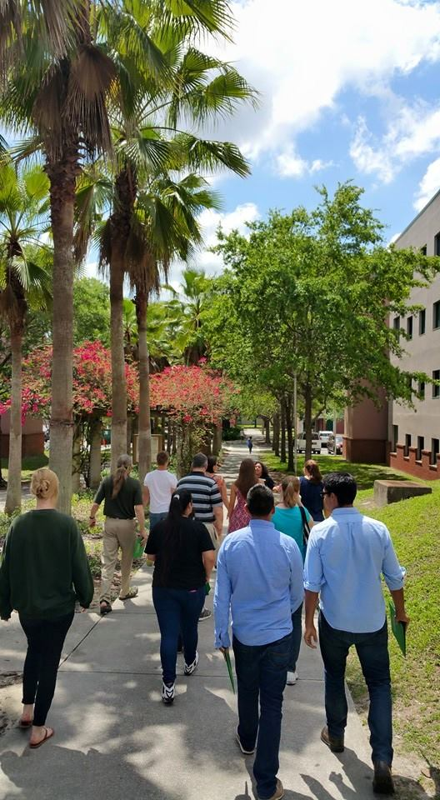
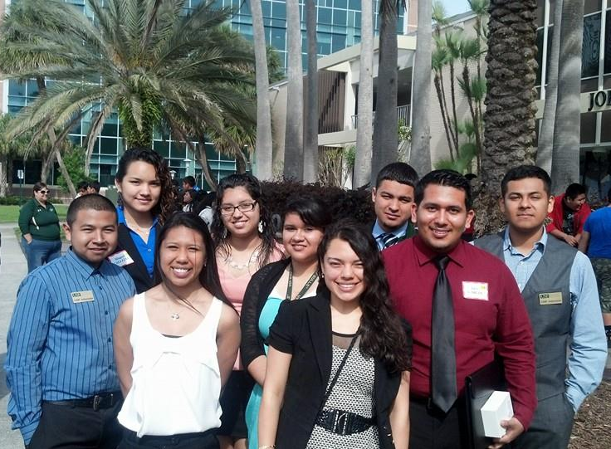
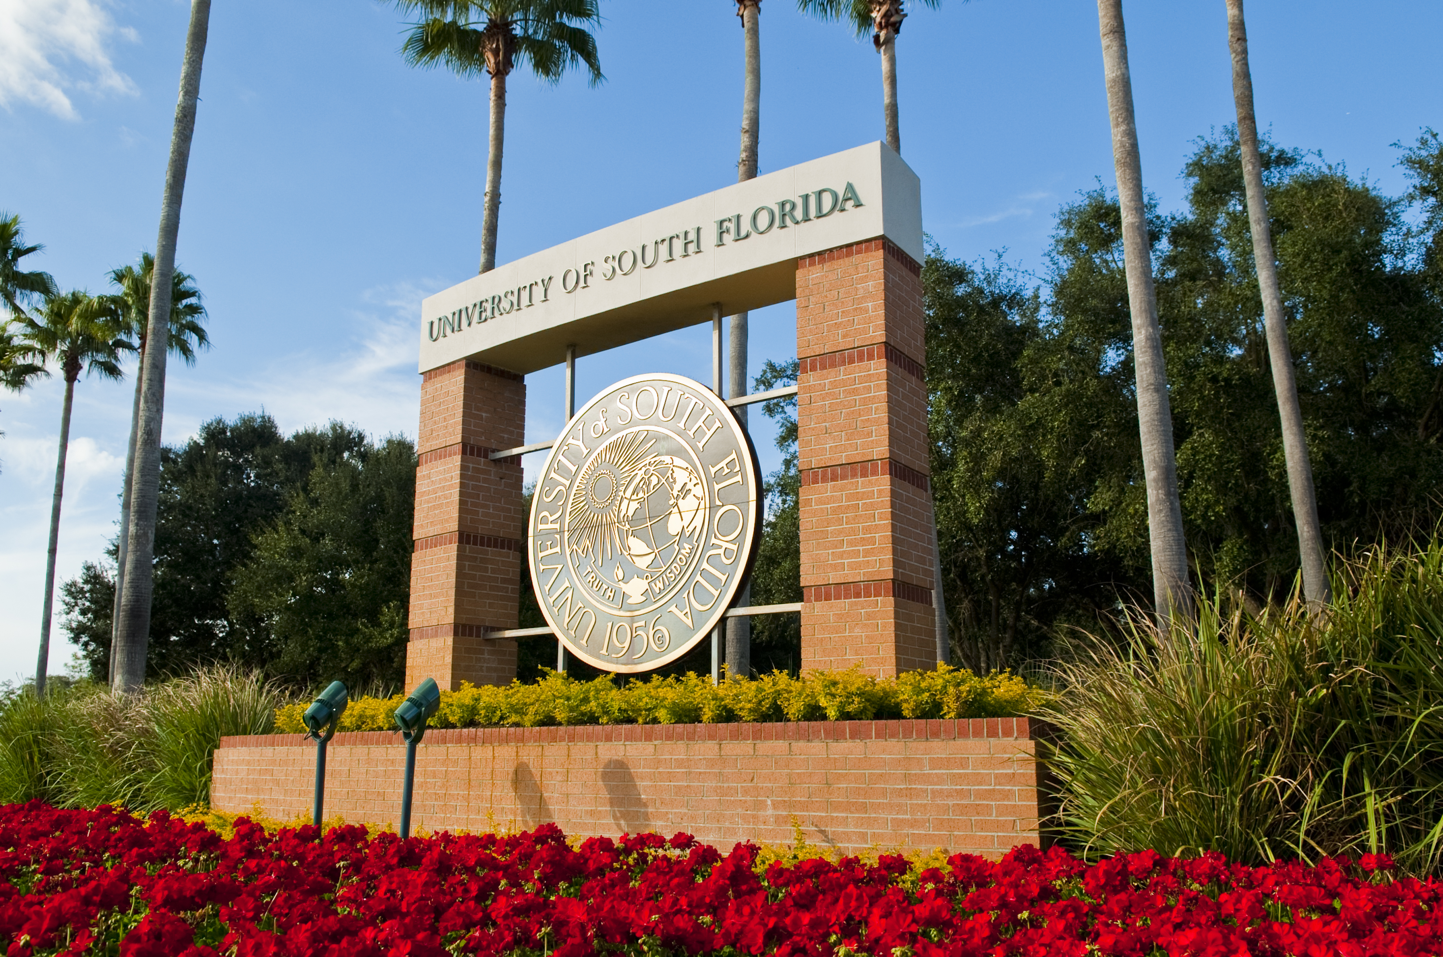

Slide 6
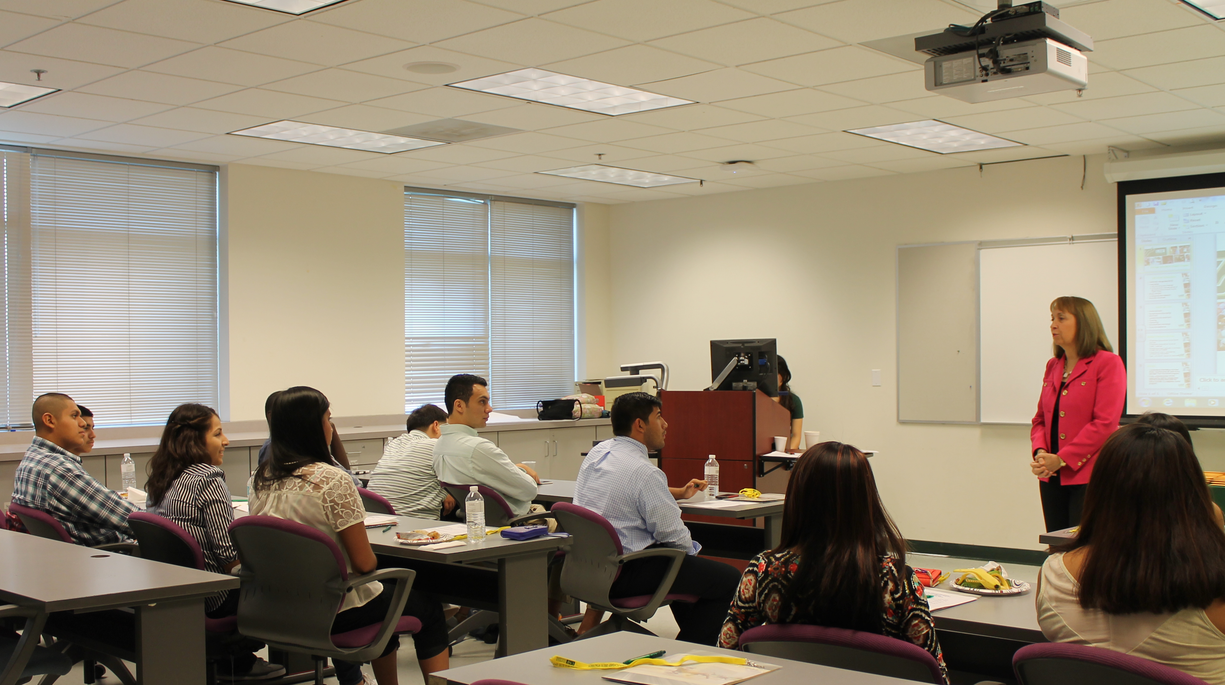
Careras
Licenciatura

Slide 8
Castor Hall

Slide 9
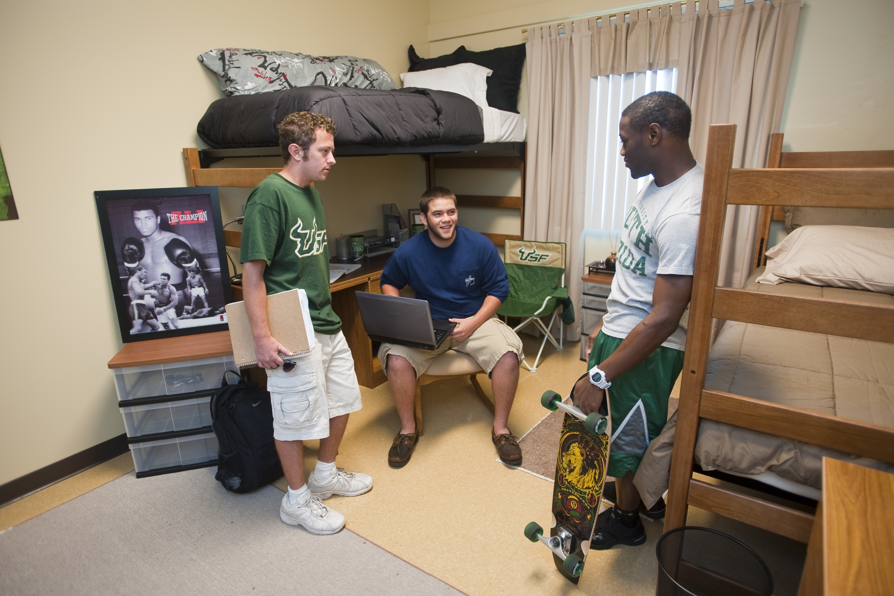
Dormitorios

Slide 10
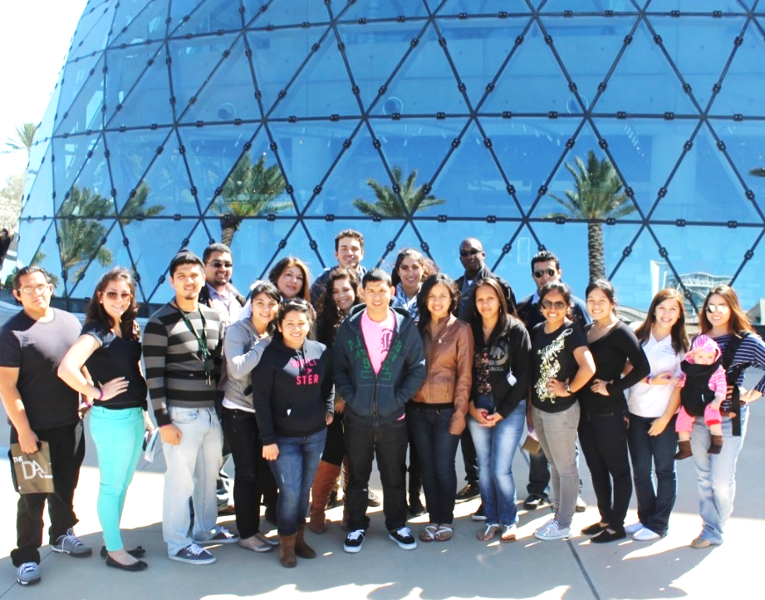
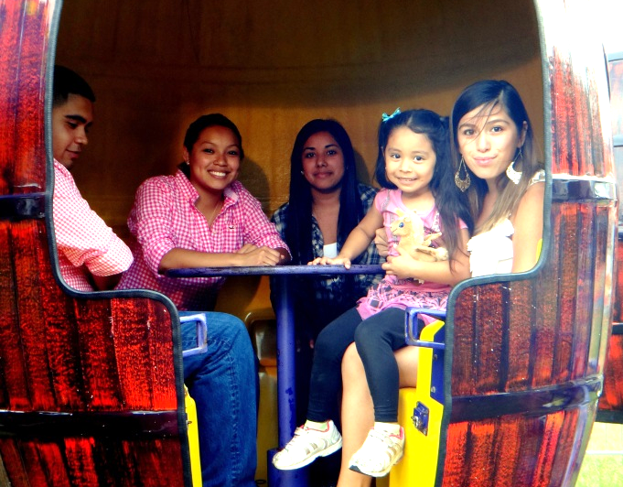
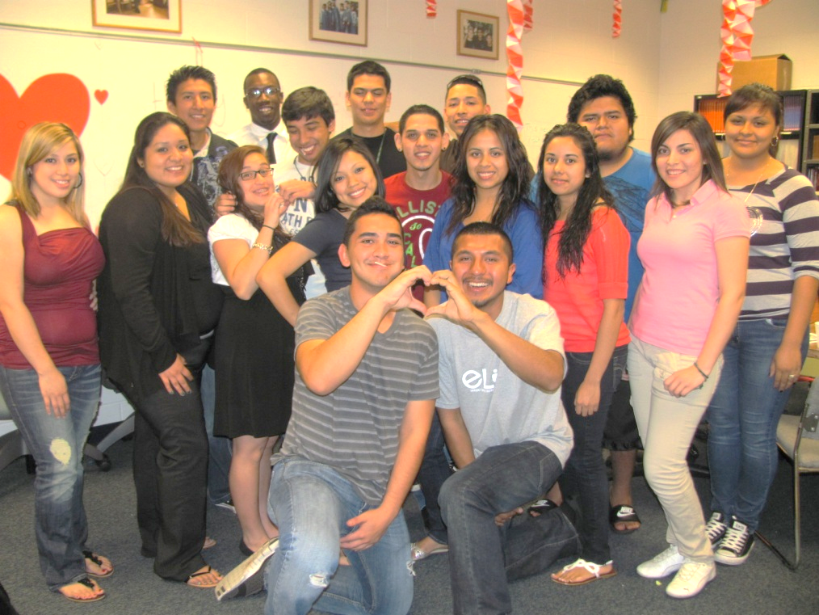
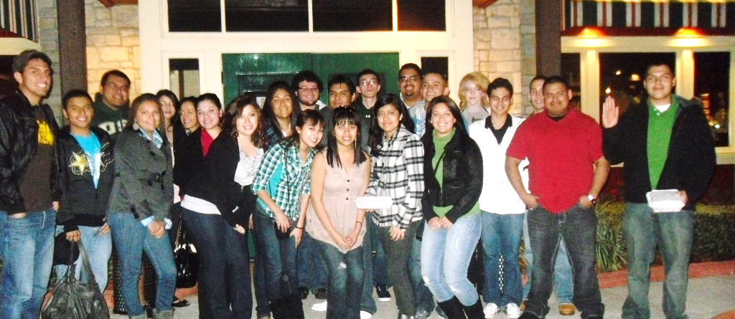
CAMP Services
Academics, Mentorship & Service

Slide 11
CAMP Scholars
2017-2018 CAMP Cohort
#OurFirstYear
Collier
Desoto
Hendy
Hillsborough
Manatee
Orange
Palm Beach
Polk
Suwannee

Slide 12
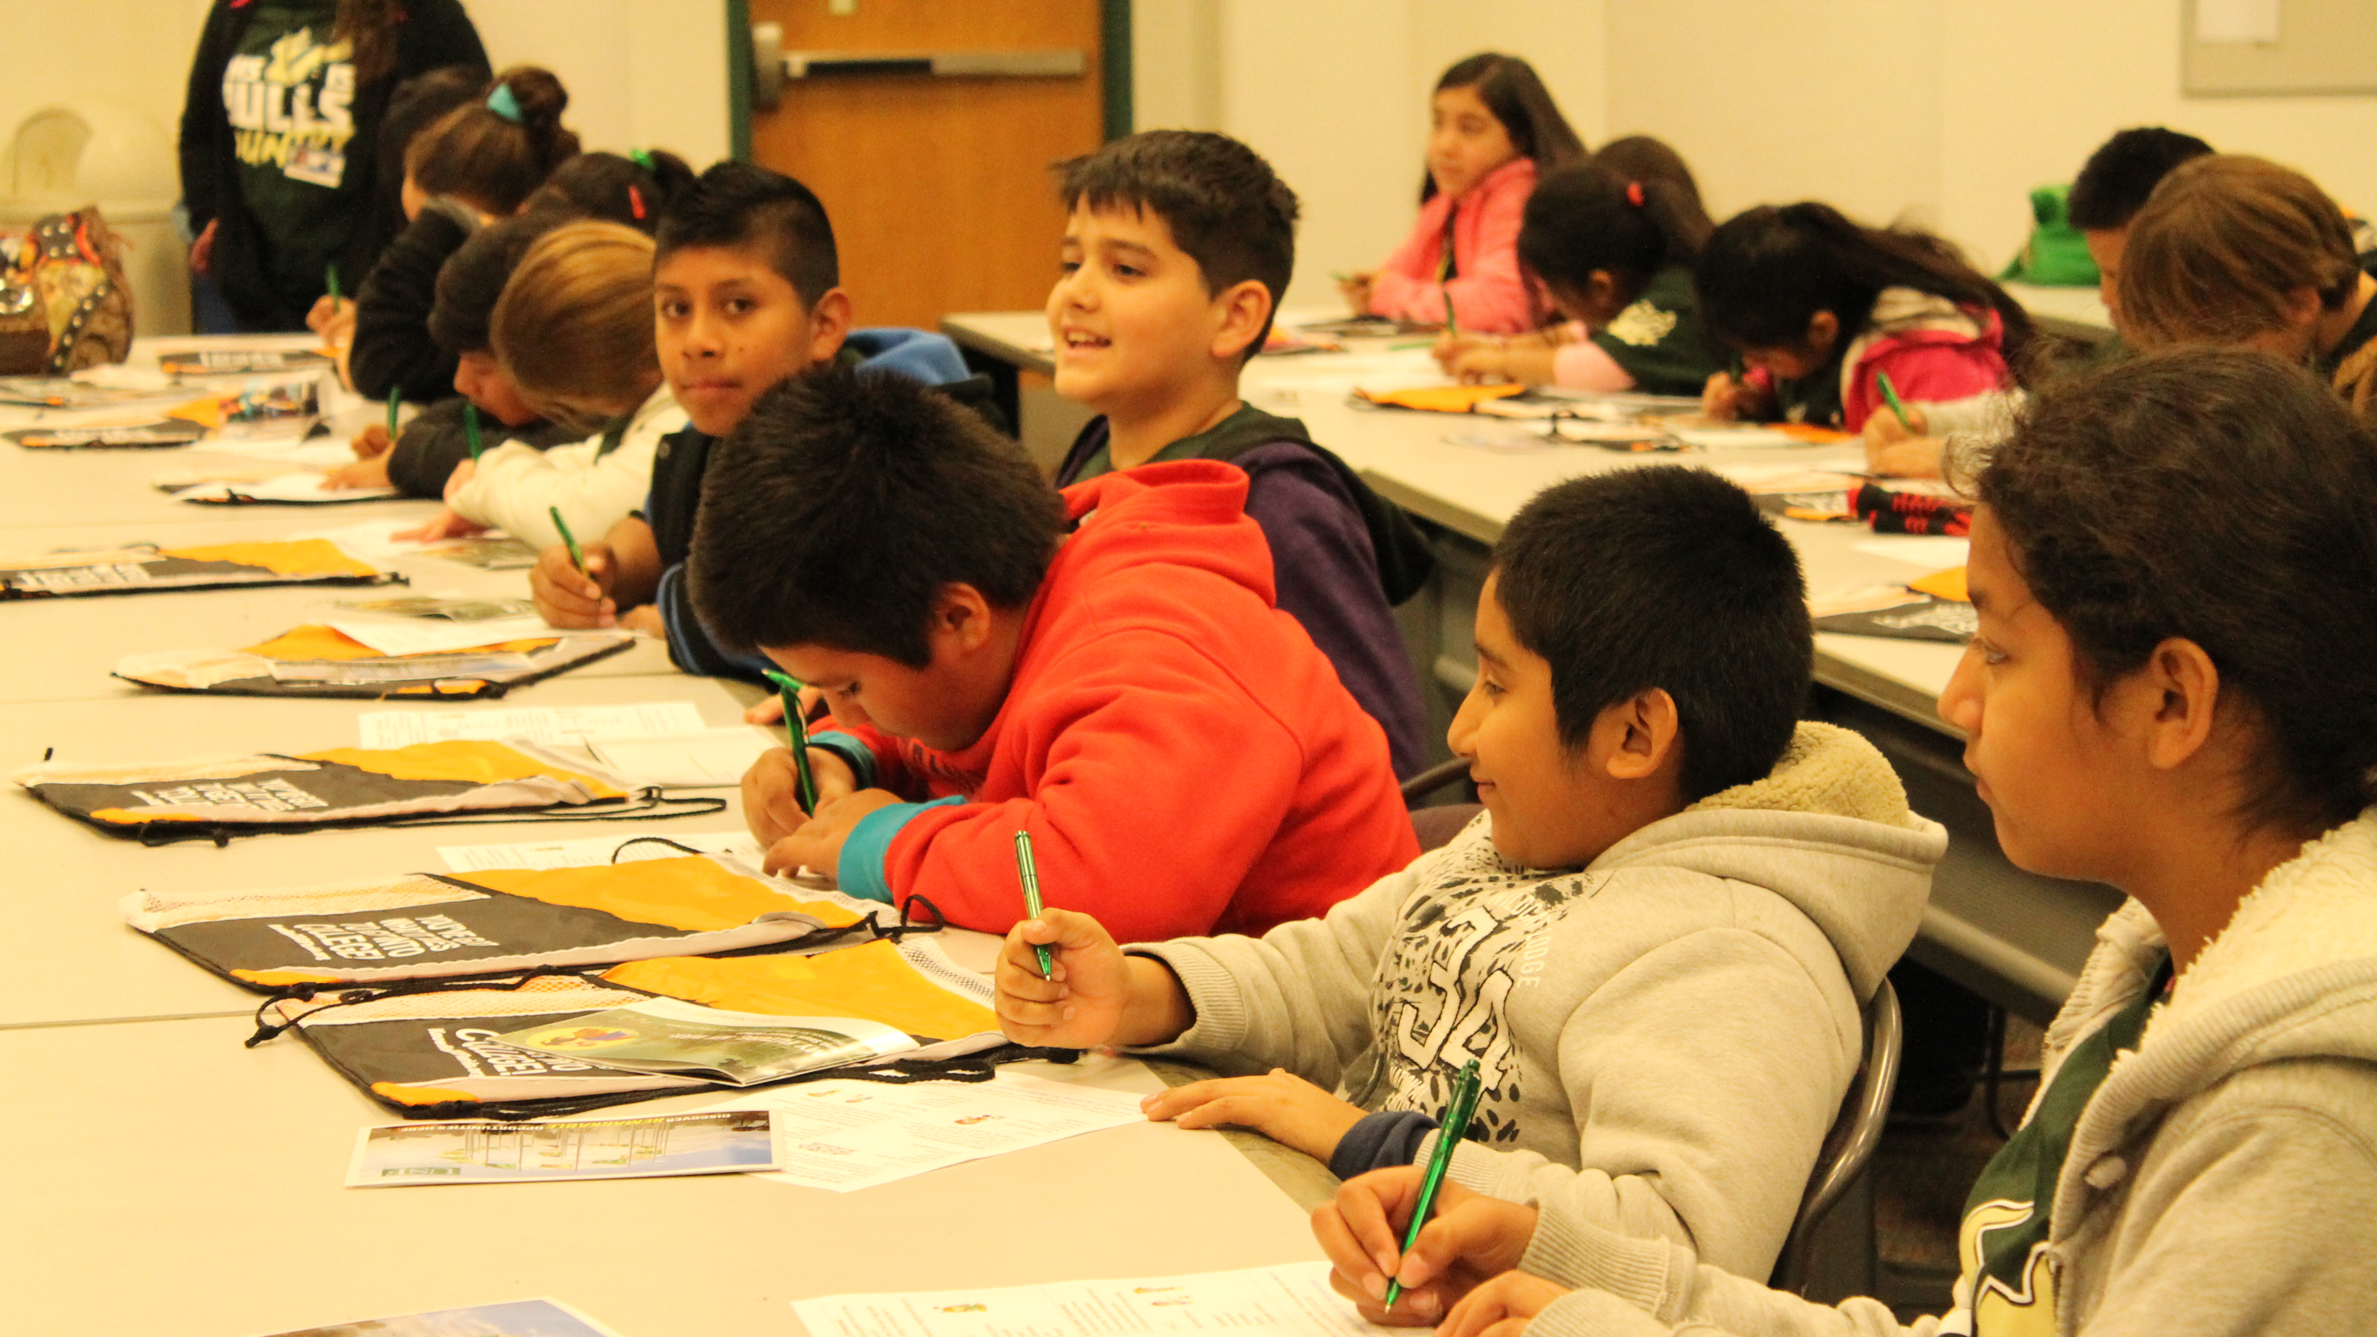
Ayuda Financiera
FAFSA: Solicitud Gratuita de Ayuda Federal para Estudiantes
Becas
Prestamos
Trabajo durante el ano escolar, Federal Work Study

Slide 13
Center for Migrant Education
Dr. Ann Cranston-Gingras
Director
Associate Director, Professor & Associate Dean for Graduate Education at the College of Education
Patrick Doone
Associate Director
Ruby Luis
Recruiter
Virginia Flores
Academic Support Specialist
Jessica Barron
Secretary

