Slide 1
Miami-Dade County Public Schools
Title I Migrant Education Program
“Increase Parental Engagement”
Notes:
Thank you for inviting me to attend your session.

Slide 2
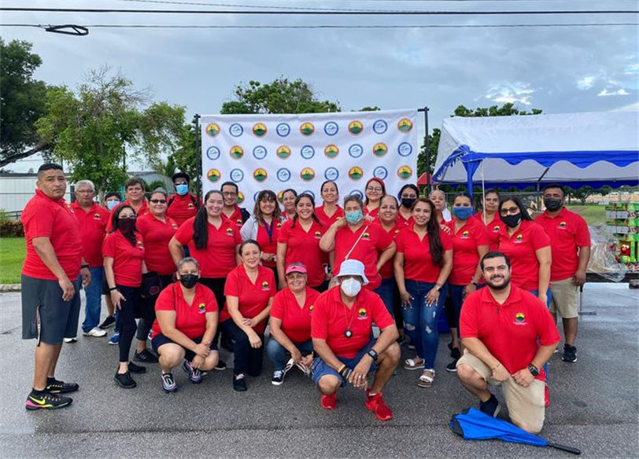
Miami-Dade County Public Schools
Title I Migrant Education Program
Notes:
My name is Erica Garcia, I work with Miami-Dade County Public Schools and I am the Executive Director for the Title I Migrant Education Program. I have been working with Miami-Dade County for 25 years as a Para, Teacher, Counselor and Administrator and am also a Licensed Mental Health Counselor for the State of Florida.
But most importantly, I am a former Migrant. My parents worked in agriculture for a very long time and I grew up in in the fields. I don’t regret how I grew up, on the contrary it made me value hard work, commitment and education.
I want you to know where I started and where I am today because I want you to know that our migrant children can achieve so much more, but we have to have the tools and willingness to help them succeed.
In this picture is the Team that I work with on a daily basis to make sure our students succeed and the majority of them come from a migrant background, graduated, some attended college and know what it takes to succeed. And they share that confidence with our students and families by inspiring the attitude of “SI SE Puede!”

Slide 3
Cultivating Partnerships!
All families have dreams for their children and want the best for them.​
All families have the capacity to support their children’s learning in one way or other.
Families and school staff must be equal partners.​
The responsibility of cultivating and sustaining partnerships among school and home rests with school staff and parents.
Notes:
So how do we do this!
Well we know that: (review bullets)

Slide 4
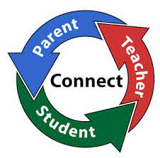
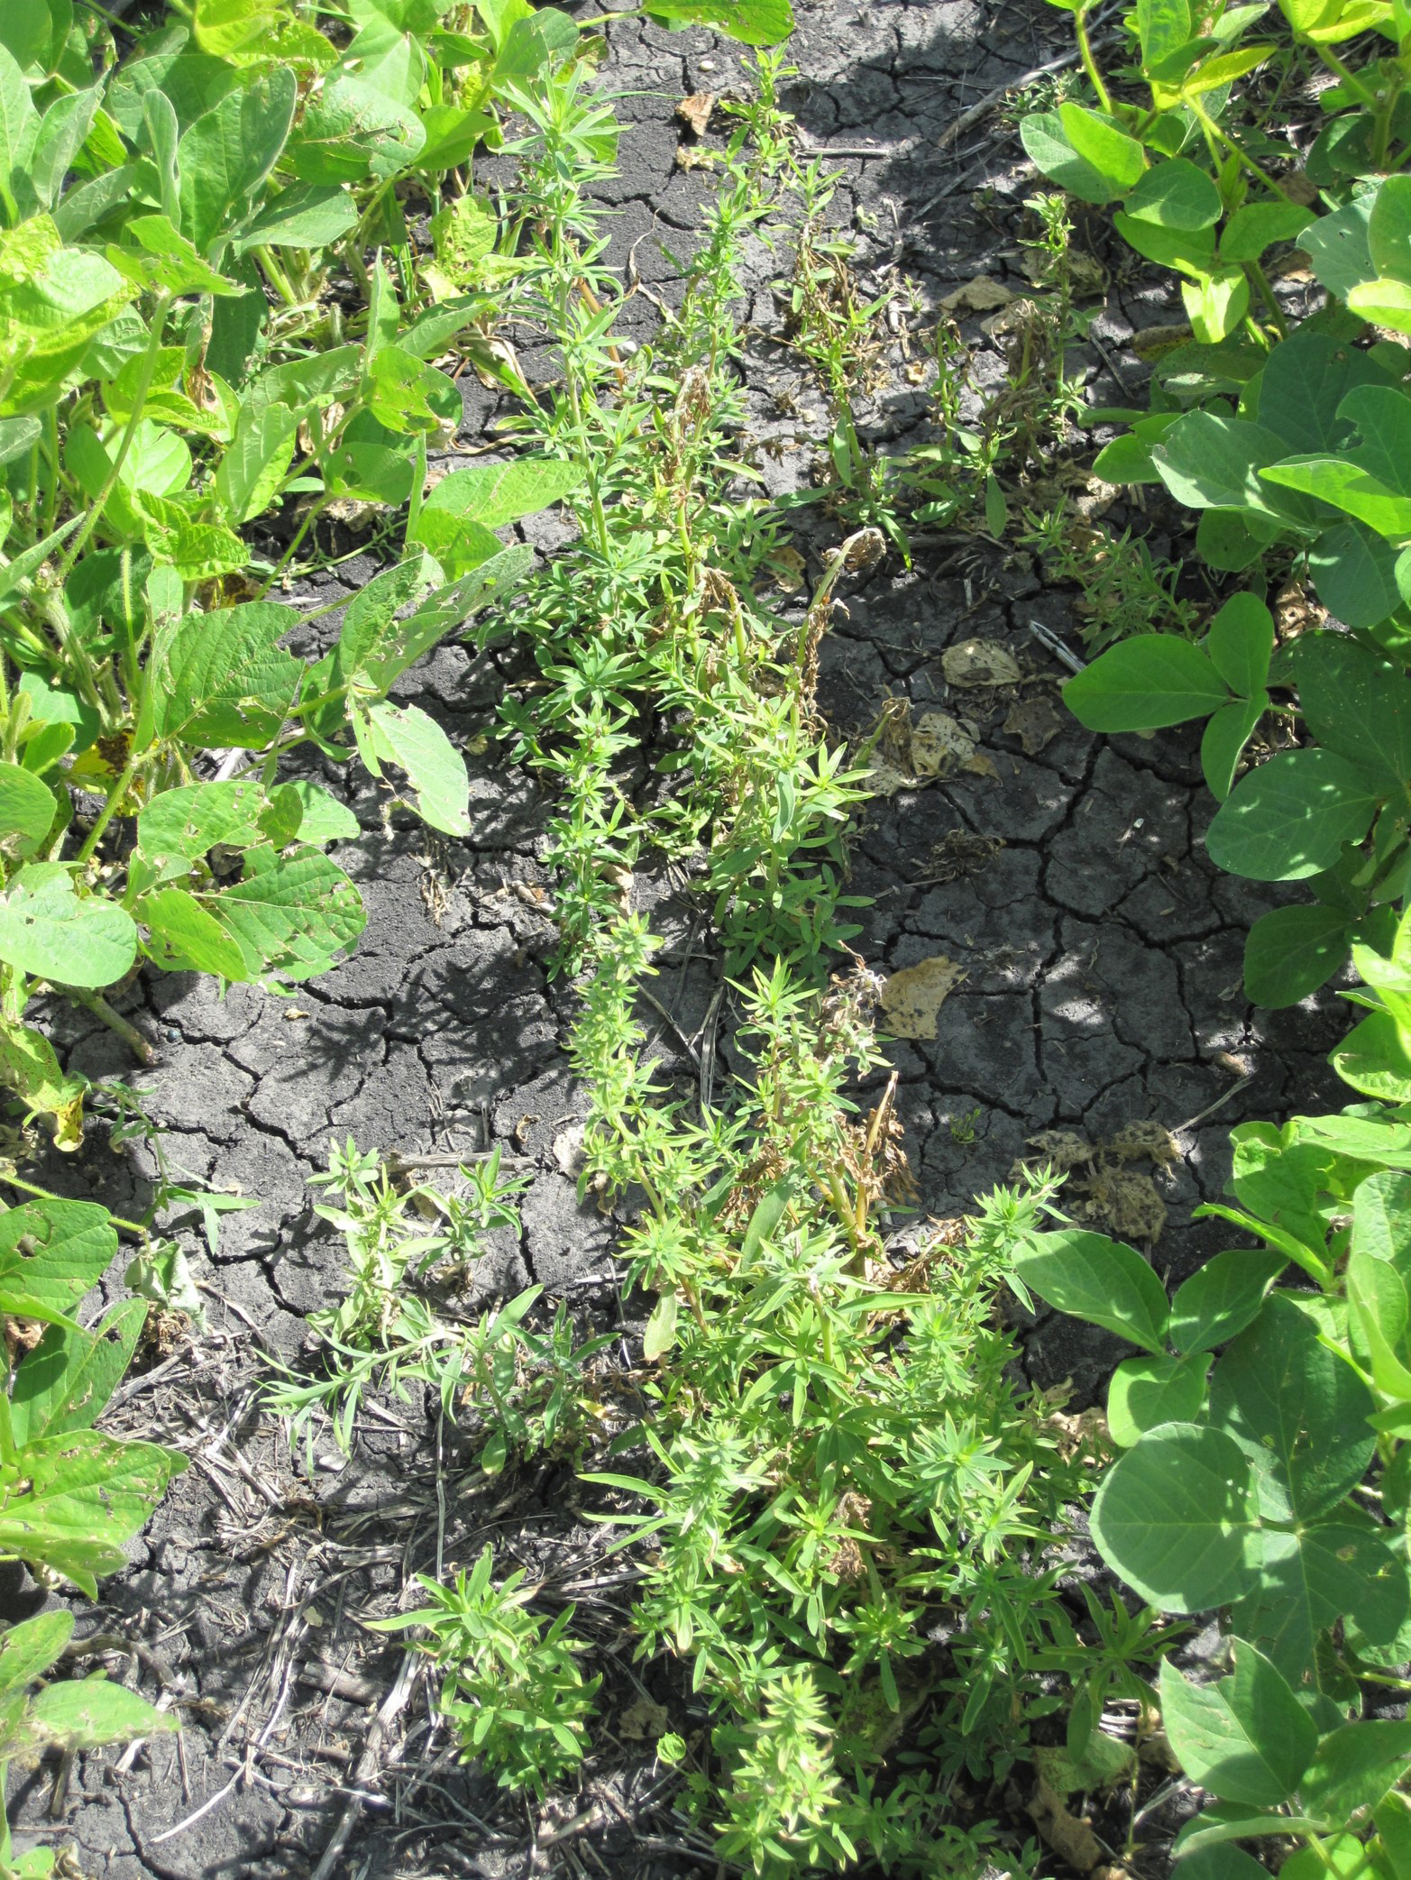
Cultivating Partnerships!
All Parent Leaders can help cultivate partnerships!
Notes:
This is where you are the vital piece in this puzzle.
You are here in this very meeting because you are Parent Leaders in your community. You have the capacity and responsibility to not only be the voice for parents but to act as a bridge between the school and community! You can help cultivate a partnership that will help students succeed.
Notice I didn’t just say our child succeed, I said our students!
In farming, what happens if you only take the weeds out of one row of crops and leave the other rows with weeds? (A.A.: Weeds will grow into your row.)
I use this as an example because if we only worry about what we do with our child then we are missing the bigger picture as Community Leaders. Students are successful when we are willing to share our knowledge and our voice to help make things better for those in our community and our schools. And as leaders you need to do 2 essential things: get involved and share the knowledge!

Slide 5
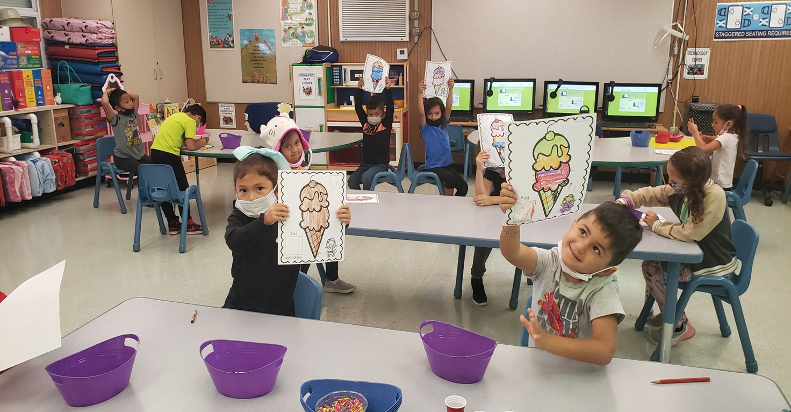
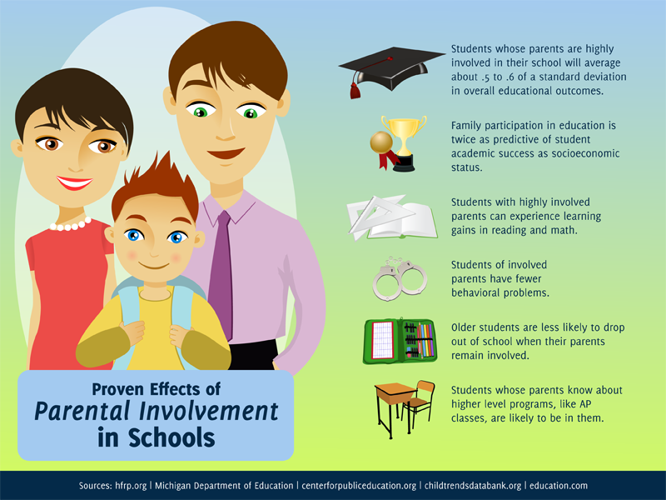
Positive Effects of Parental Engagement
When families are stakeholders in students’ education, there’s a positive impact on student success.
When families get involved and engaged in their child’s education, students are more likely to:
graduate for high school;
earn higher grades;
show gains in reading and math;
have better attendance;
less likely to have behavior issues;
more likely to go to college.
Notes:
What knowledge!
Well I’ll tell you:
So in 1970’s people started to pay more attention to studies that showed that there were gaps in learning and income between different races. And more and more studies started to show that education was the biggest indicator. In those studies, one of the strongest factors for student success was Parent Engagement.
So what do we know now, well we know: (review slide)

Slide 6
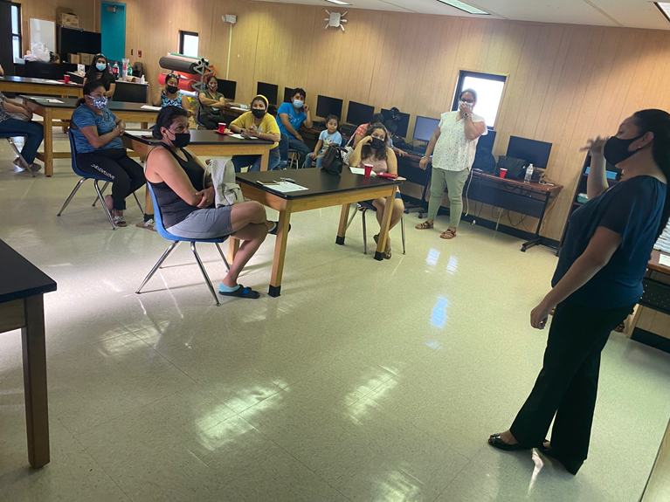
What do studies say?
Studies show that increased communication efforts between families and schools can have a positive impact on school success and student outcomes.
Nellie Maye Education Foundation
Notes:
Research shows that students do better when families and educators work together as equal partners and two-way communication is key.
If you think back to last year, do you wish you had been in communication more regularly with your child's school? Do you wish you were able to overcome any translation barriers that may have existed? Would it have been helpful if your school knew what your children were facing outside of the classroom from time to time so that they could better support them in the classroom? (ie. Internet issues, child care issues, computer issues)

Slide 7
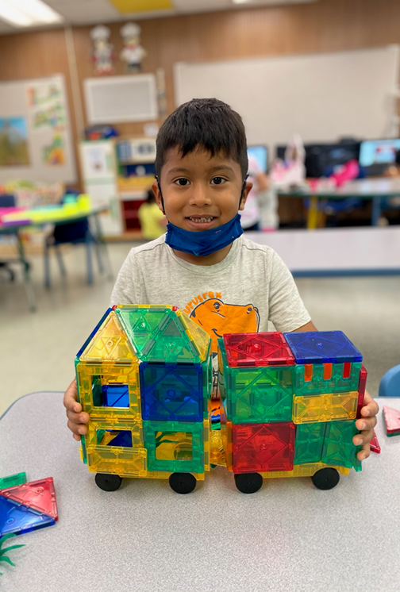
Migrant Early Childhood Learning Program
Parent Engagement
Students do better when families and educators work together as equal partners.
Flamboyan Foundation
Notes:
As Parent leaders in your community, it’s important to help increase communication between families and schools because we know that it can have a positive impact on school success and student outcomes. And who here doesn’t want there child to attend a successful school?
Family engagement leads to higher graduation rates and academic performance.

Slide 8
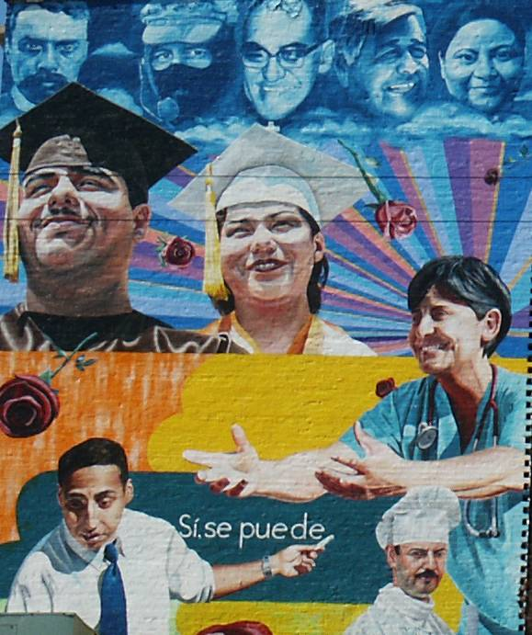
Migrant Early Childhood Learning Program
Parent Engagement
Family engagement is associated with reduced drop-out rates and higher graduation rates.
In a study of high school dropouts, 71% of diverse teenagers interviewed said that more communication between parents and schools might have prevented them from dropping out of school.²
The Gates Foundation
Notes:
Other studies have shown that: (review slide)
Students actually appreciate when their families and schools are engaged with one another because they believe it helps them stay on track.

Slide 9
Positive communication makes a difference!
Create opportunities for Positive communication in your community!
Key Number is:
5:1
Notes:
We also know that positive communication with families is important.
Here is a scale with one blue block on the right and five pink blocks on the left.
This 5 to 1 ratio shows us that in order to maintain a healthy relationship between families and schools, we need to ensure we communicate 5 positive messages for every one negative message. While this might sound like a lot, it’s not impossible!
And on a schools part it can be as simple as “How are you and your family doing? I care that you’re okay!” or “Sara did an awesome job this week with her english assignment.”
On a parents behalf it can be as simple as “How can I help with morning drop off?” or “When are your PTA or EESAC meetings, I would like to be supportive?”
Sending these positive messages on a regular basis makes it easier to have harder conversations when we need to have them because we’ve already built a positive relationship and sense of trust between schools and families.
By having that trust in place, both parties know we are coming from a good, supportive place when we might need to talk about things like test score or school climate.

Slide 10
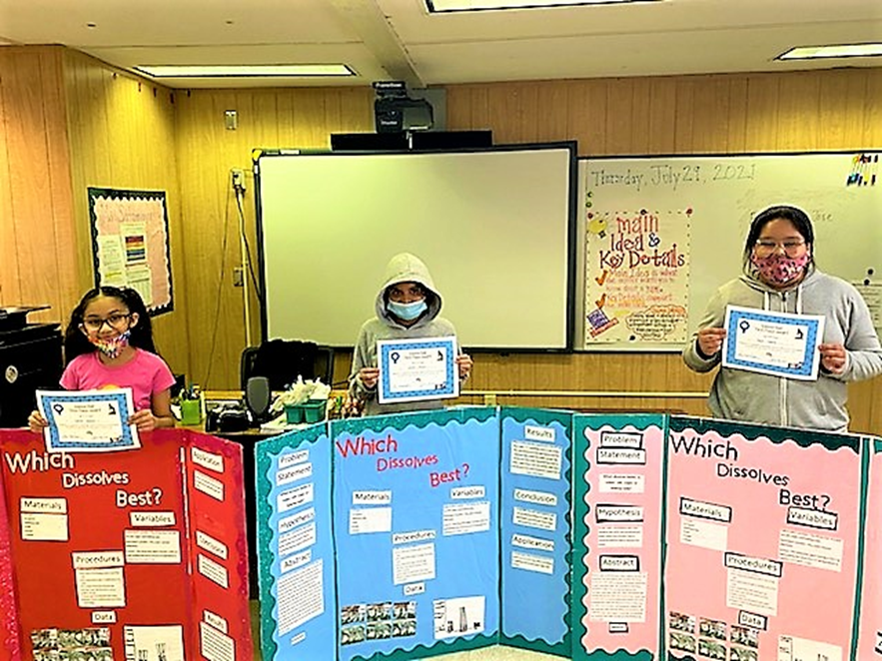
You can make a difference!
Parents are the most important corner stone for student success!
Notes:
You can make a difference as a Parent Leader and share this knowledge with other families. Lead by example!
Although success looks different to each and everyone of us the foundation starts with students education.
(It takes all three for the student to succeed and the Parents are the most important corner stone for student success!)

Slide 11
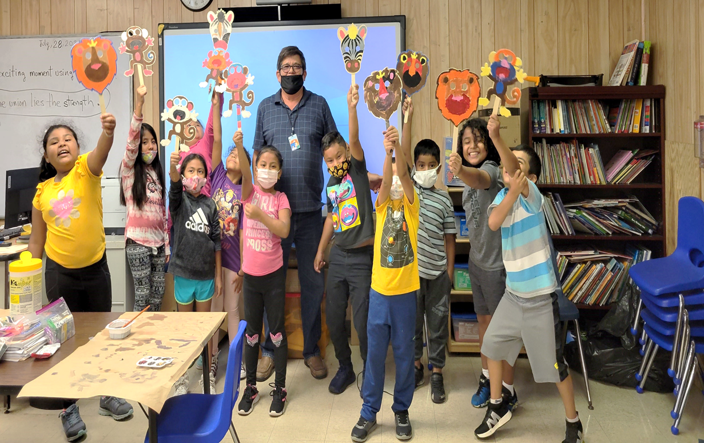
Influences on Family Engagement
Families’ involvement in their child’s education is impacted by:
Their own educational experiences​
Their own parents’ involvement in their school experience ​
Beliefs shaped by culture and values​
Family responsibilities and time commitments​
Notes:
So if it’s that easy why do we not have more parent engagement!

Slide 12
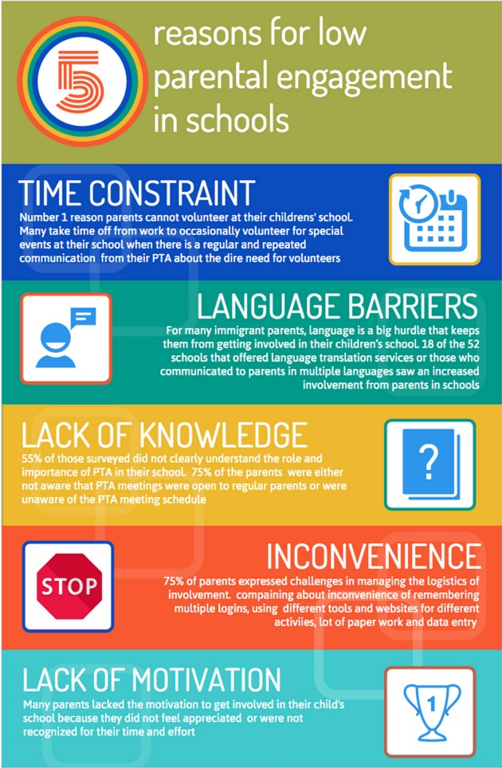
Why are parents not involved?
Notes:
So what are the top 5 reasons that keep coming up for parents not being engaged and what can you do to help:
Time constraints: Communicate to schools what is the best time for parents to meet (ie: early mornings, late evenings, weekends).
Language Barriers: Find a parent or school staff able to translate, different areas have different needs (ie: Mum, Creole, Meztico)
Lack of knowledge: Share with schools and parents that customs are different when it comes to education (some take a less or stricter approach).
Inconvenience: Some parents have difficulties in signing up for workshops and will need help ( talk to school staff about simplifying the process or having an alternative way to sign up).
Lack of Motivation: Help by recognizing your parents for participating and show them they are appreciated. As a Parent Leader suggest to your school to do a certificate or send out a thank you message to those involved.

Slide 13
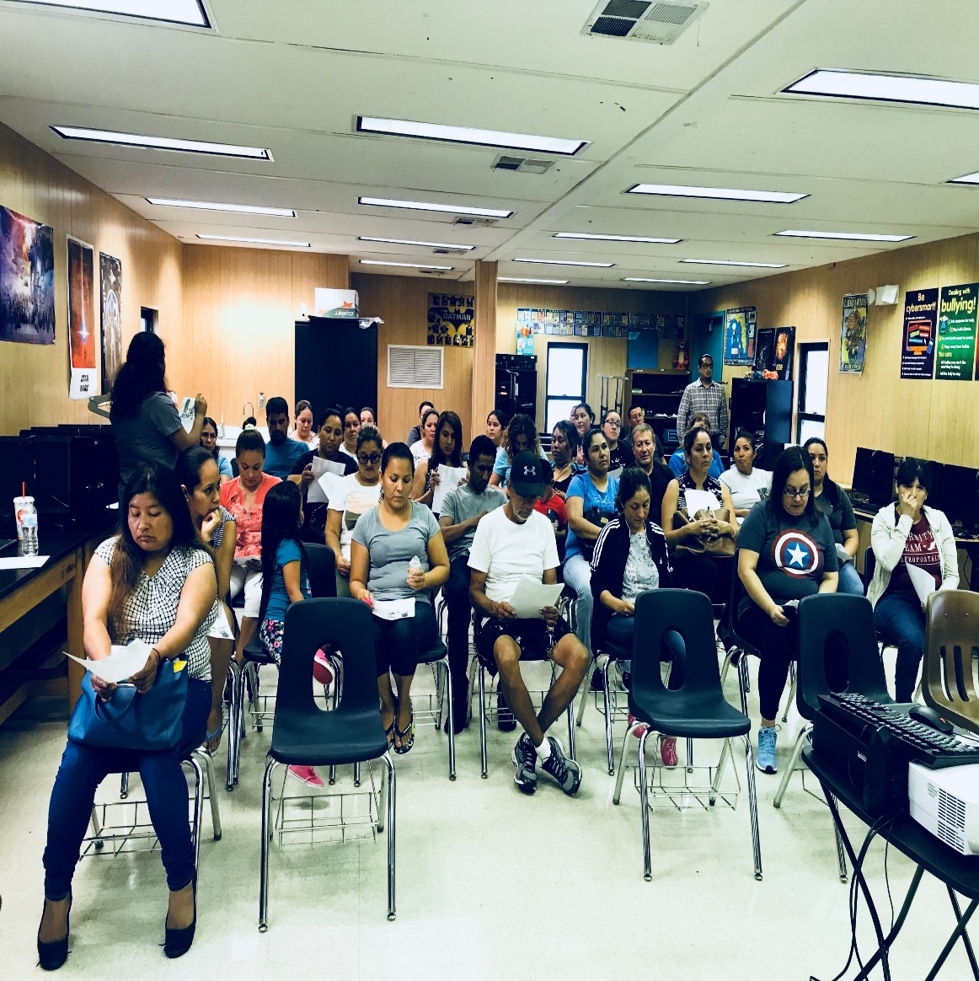
Be specific!
Notes:
Communicate with schools about specific parent needs. Schools are eager to host impactful workshops and engage parents! No one wants to waste time on something they don’t need. Give your parents a voice.

Slide 14
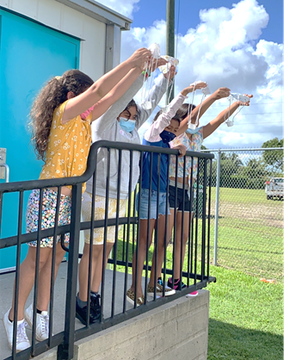
What can family engagement look like at your school?
Family involvement and engagement can include discussions about:
Communication between families and students about school and academics
Help with homework and studying
Discussions about areas in need of improvement, progress, and achievements in the school
Creating a home environment conducive to studying
Clear educational and academic expectations
Communication between family and school
Parent participation or attendance at school and at after-school functions
Notes:
So what can you bring to the table as a Parent Leader to discussions with schools. Remember you are the voice of your families! Here are some sessions you may wants to discuss setting up at your school.

Slide 15
What do we do in M-DCPS Title I MEP to Engage Parents?
Parent participation in workshops, parent-teacher conferences, and other school/community activities are infused to include parents as partners in their children’s educational process.
Notes:
So we have talked a lot about the research and why it is important that you share this with the parents in your community. We also talked about the importance of communication, why it’s important and how to build positive communication and gave you some ideas of what you can bring up in conversations with school staff to build engagement.
Now I would like to tell you a little about what we do in MDCPS Title I MEP that has helped us build engagement with families. Keep in mind that every community is different and maybe what works for us may not work in your community. Remember you represent your community and may know what works for them better.
We host a variety of workshops and activities to engage parents as partners.

Slide 16
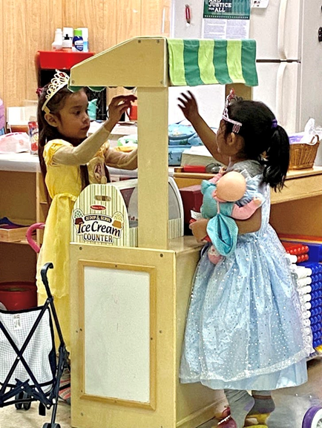
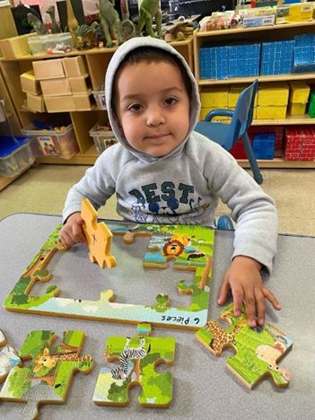
Migrant Early Childhood Learning Program
Student Experience
The MECLP addresses the needs of the whole child, as children are involved in hands-on experiences with people, objects, ideas, and events.
MECLP takes a culturally sensitive approach to parental involvement and keeps the unique needs of the migrant community at the forefront of all activities.
Notes:
We are luck to have a Pre-K Program at 2 of our sites where we take a holistic approach to learning.

Slide 17
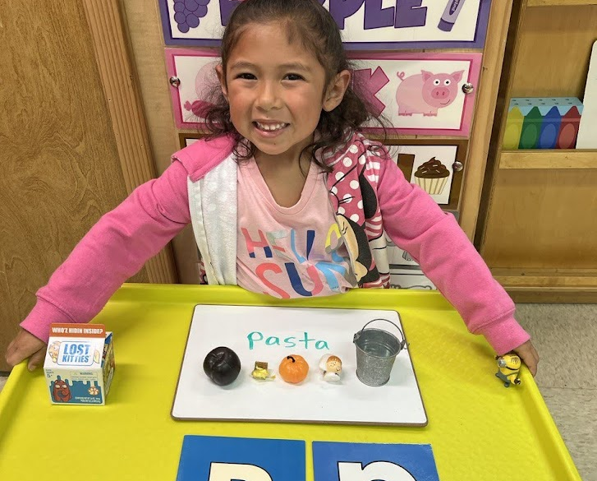
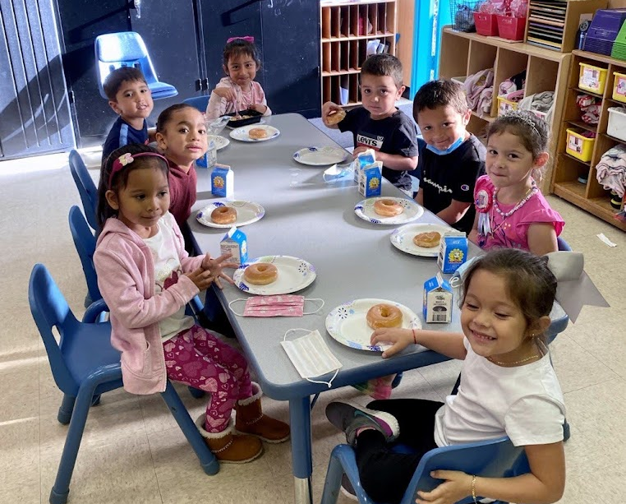
Orientation Meetings
Camp parent orientation meetings take place at the three major camps during the beginning of the school year.
These meetings provide:
contact information and details about schools their children attend;
Information about the MEP and services we provide;
resources on how to help your child succeed in school.
Notes:
Camp parent orientation meetings take place at the three major camps during the beginning of the school year.

Slide 18
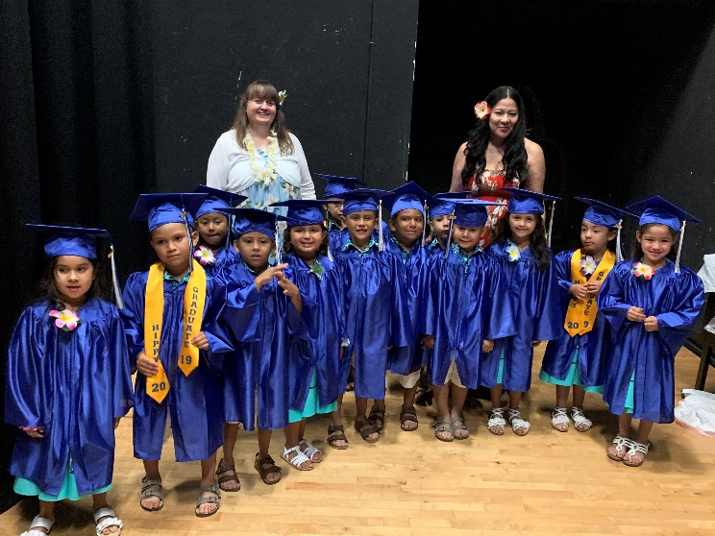
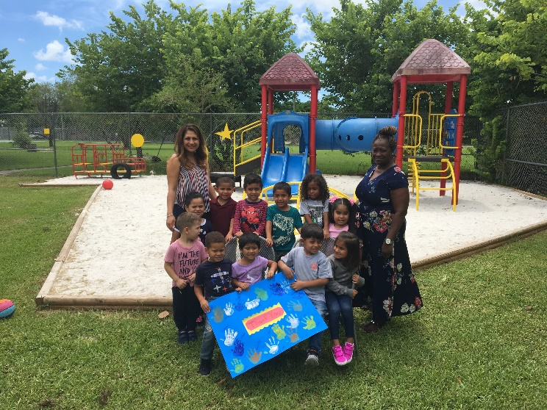
Activities to Engage Parents
Family Literacy Night
Pre-K Celebration
Holiday Celebrations
Senior Banquet
Thanksgiving Food Basket Drive
Annual Winter Holiday Program
Notes:
We host a variety of other activities to engage families that can easily be duplicated by other counties, such as:
Our Family Literacy Night which gives parents an opportunity to spend quality time with their child while becoming actively involved in the learning process.
Our PREKINDERGARTEN Celebration, where we recognize migrant preschool students as a start of the many great things to come and the aspiration of what they must accomplish to reach their academic goals and receive their high school diploma.
Seniors Banquet is our culminating recognition of seniors and parents for reaching this important milestone!
Holiday celebrations that include our families and highlight their culture!
THANKSGIVING FOOD BASKETS distribution, thanks to generous donations from community partners and collaborative efforts, some of our neediest migrant families in the community and migrant housing centers receive food baskets every year during the Thanksgiving Holiday Season.
ANNUAL WINTER HOLIDAY PROGRAM The Annual Winter Holiday program is a yearly Family/Parental event put together by the Title I Migrant Program, teachers, staff, and students.

Slide 19
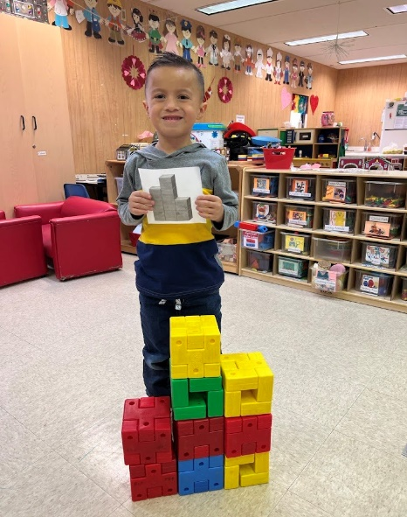
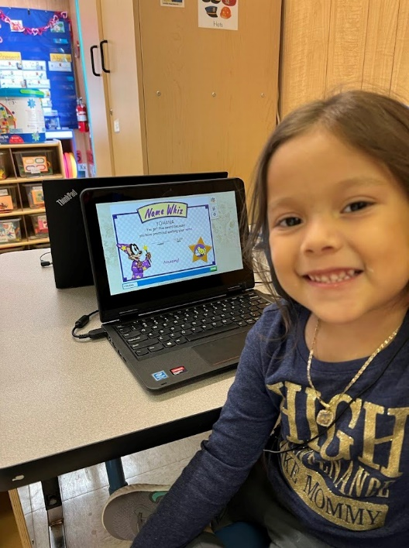
Parent Involvement Specialist
Parent involvement takes place on an ongoing basis.
A team of Parent Specialists are key to our program!
Notes:
We are lucky to have one of our greatest components, our Parent Specialist. Our Parents Specialist plans, coordinates, organizes and implements all activities with regards to parent meetings, orientations, trainings, resources, and services as well as run the Parent Resource Center which includes food banks, clothing banks, computer and instructional activities for parents.

Slide 20
Ways to communicate with parents!
Website
Social media accounts
Email
Newsletters
School Messenger messages
Parent portal
Remote learning online platform
Notes:
As you know there are various ways the districts and your schools communicate with families.
Our school district primarily uses:
(review bullets)
But you may know other ways families in community get information. Share with your school what is the best way to communicate with the parents in your community.
We found that the best ways to communicate with many of our families is by using WhatsApp, flyers distributes by the housing association, phone calls and word of mouth.
You can make a difference in speaking to your school a better ways to get important information to parents.

Slide 21
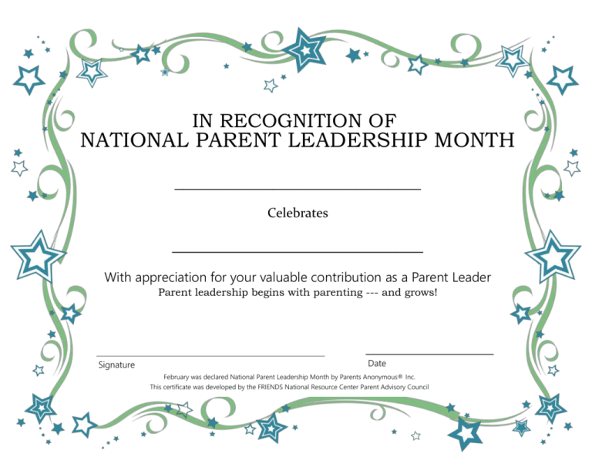
Recognize Your Parents
Notes:
Last and most important recognize your parents as I would like to congratulate you for taking part in this session with me. A little thank you for the time other parents spend with you goes a long way!
Again, know that the schools want parents as partners and as Parent Leaders you can make this possible! I hope you can take away at least one thing that will help you as a leader to increase parental engagement in your community and your school. Thank for your time and Congratulations on having been elected as Parent Leaders in your community!

Slide 22
Miami-Dade County Public Schools
Title I Migrant Education Program
For more information, please contact:
Title I Migrant Education Program 28205 SW 124th Court, Bldg. F, room F014 Homestead, FL 33033 305-258-4115
Erica Garcia, Executive Director
egarcia5@dadeschools.net
Click on the link below to learn more about the History and Purpose of the Migrant Education Program
https://youtu.be/DckPww8V-Ck
Notes:
Please feel free to contact me if you would like any other information.

